Slide 1
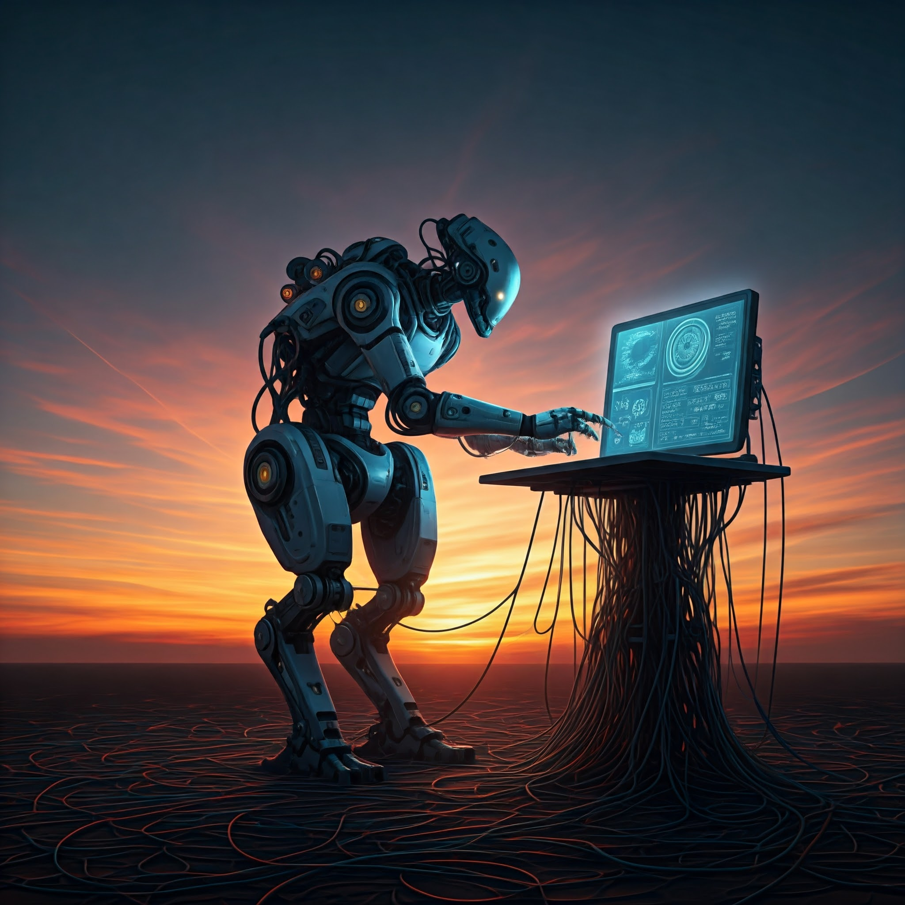
PROJECT-TITLE: ROLE OF OPERATING SYSTEMS IN ROBOTICS
PRESENTED BY: PRAMODH NARAIN
CHANNEL: PRAMODH CODE CRAFTER
DATE: 17-10-2024
A CASE STUDY ANALYSIS

Slide 2
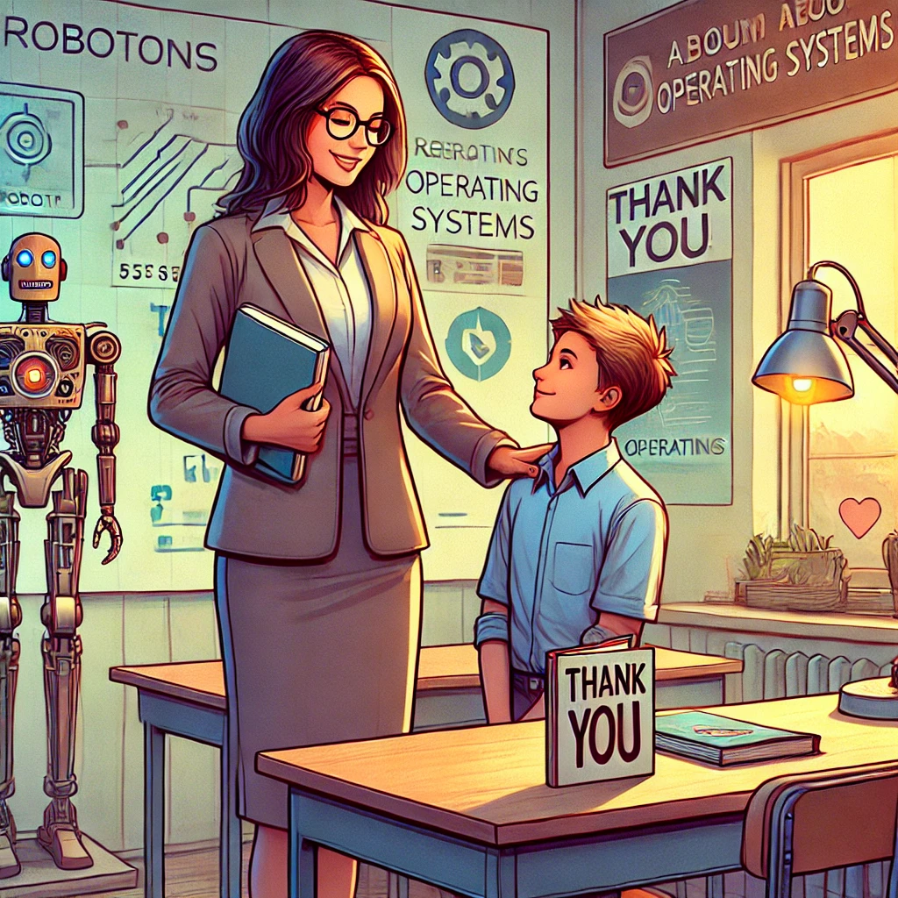
ACKNOWLEDGMENT
I would like to extend my heartfelt thanks to my Operating Systems teacher for offering valuable insights and guidance during the course of this project. The support and encouragement provided have significantly contributed to my understanding and successful completion of this study. I truly appreciate the time and expertise shared, which helped me develop a deeper grasp of this intricate subject.

Slide 3
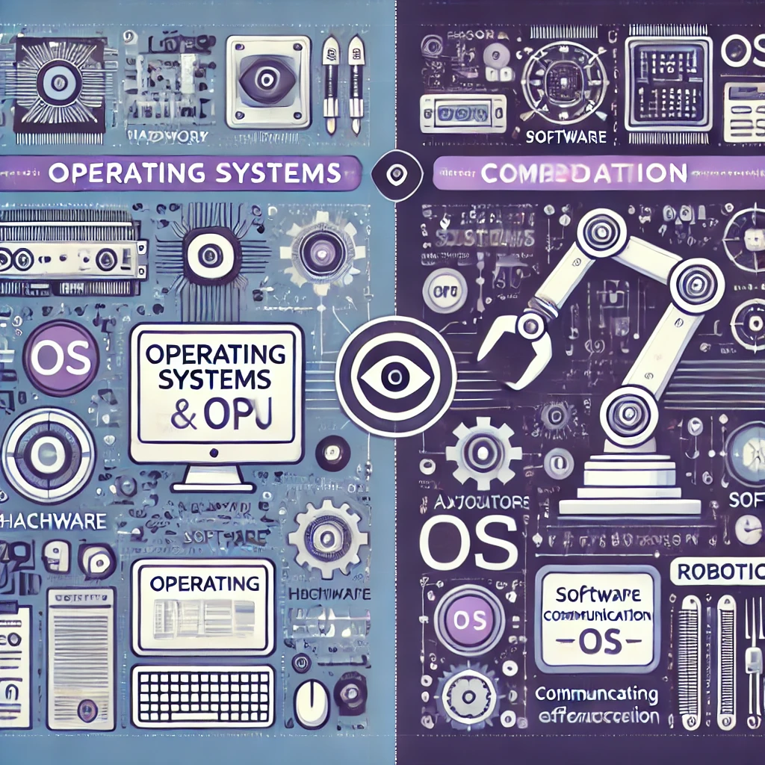
INTRODUCTION
Why is this topic important?
Operating Systems [OS]: The backbone of any computing system, managing hardware and software resources efficiently.
Robotics: Ensures smooth communication between sensors, actuators, and decision making units

Slide 4
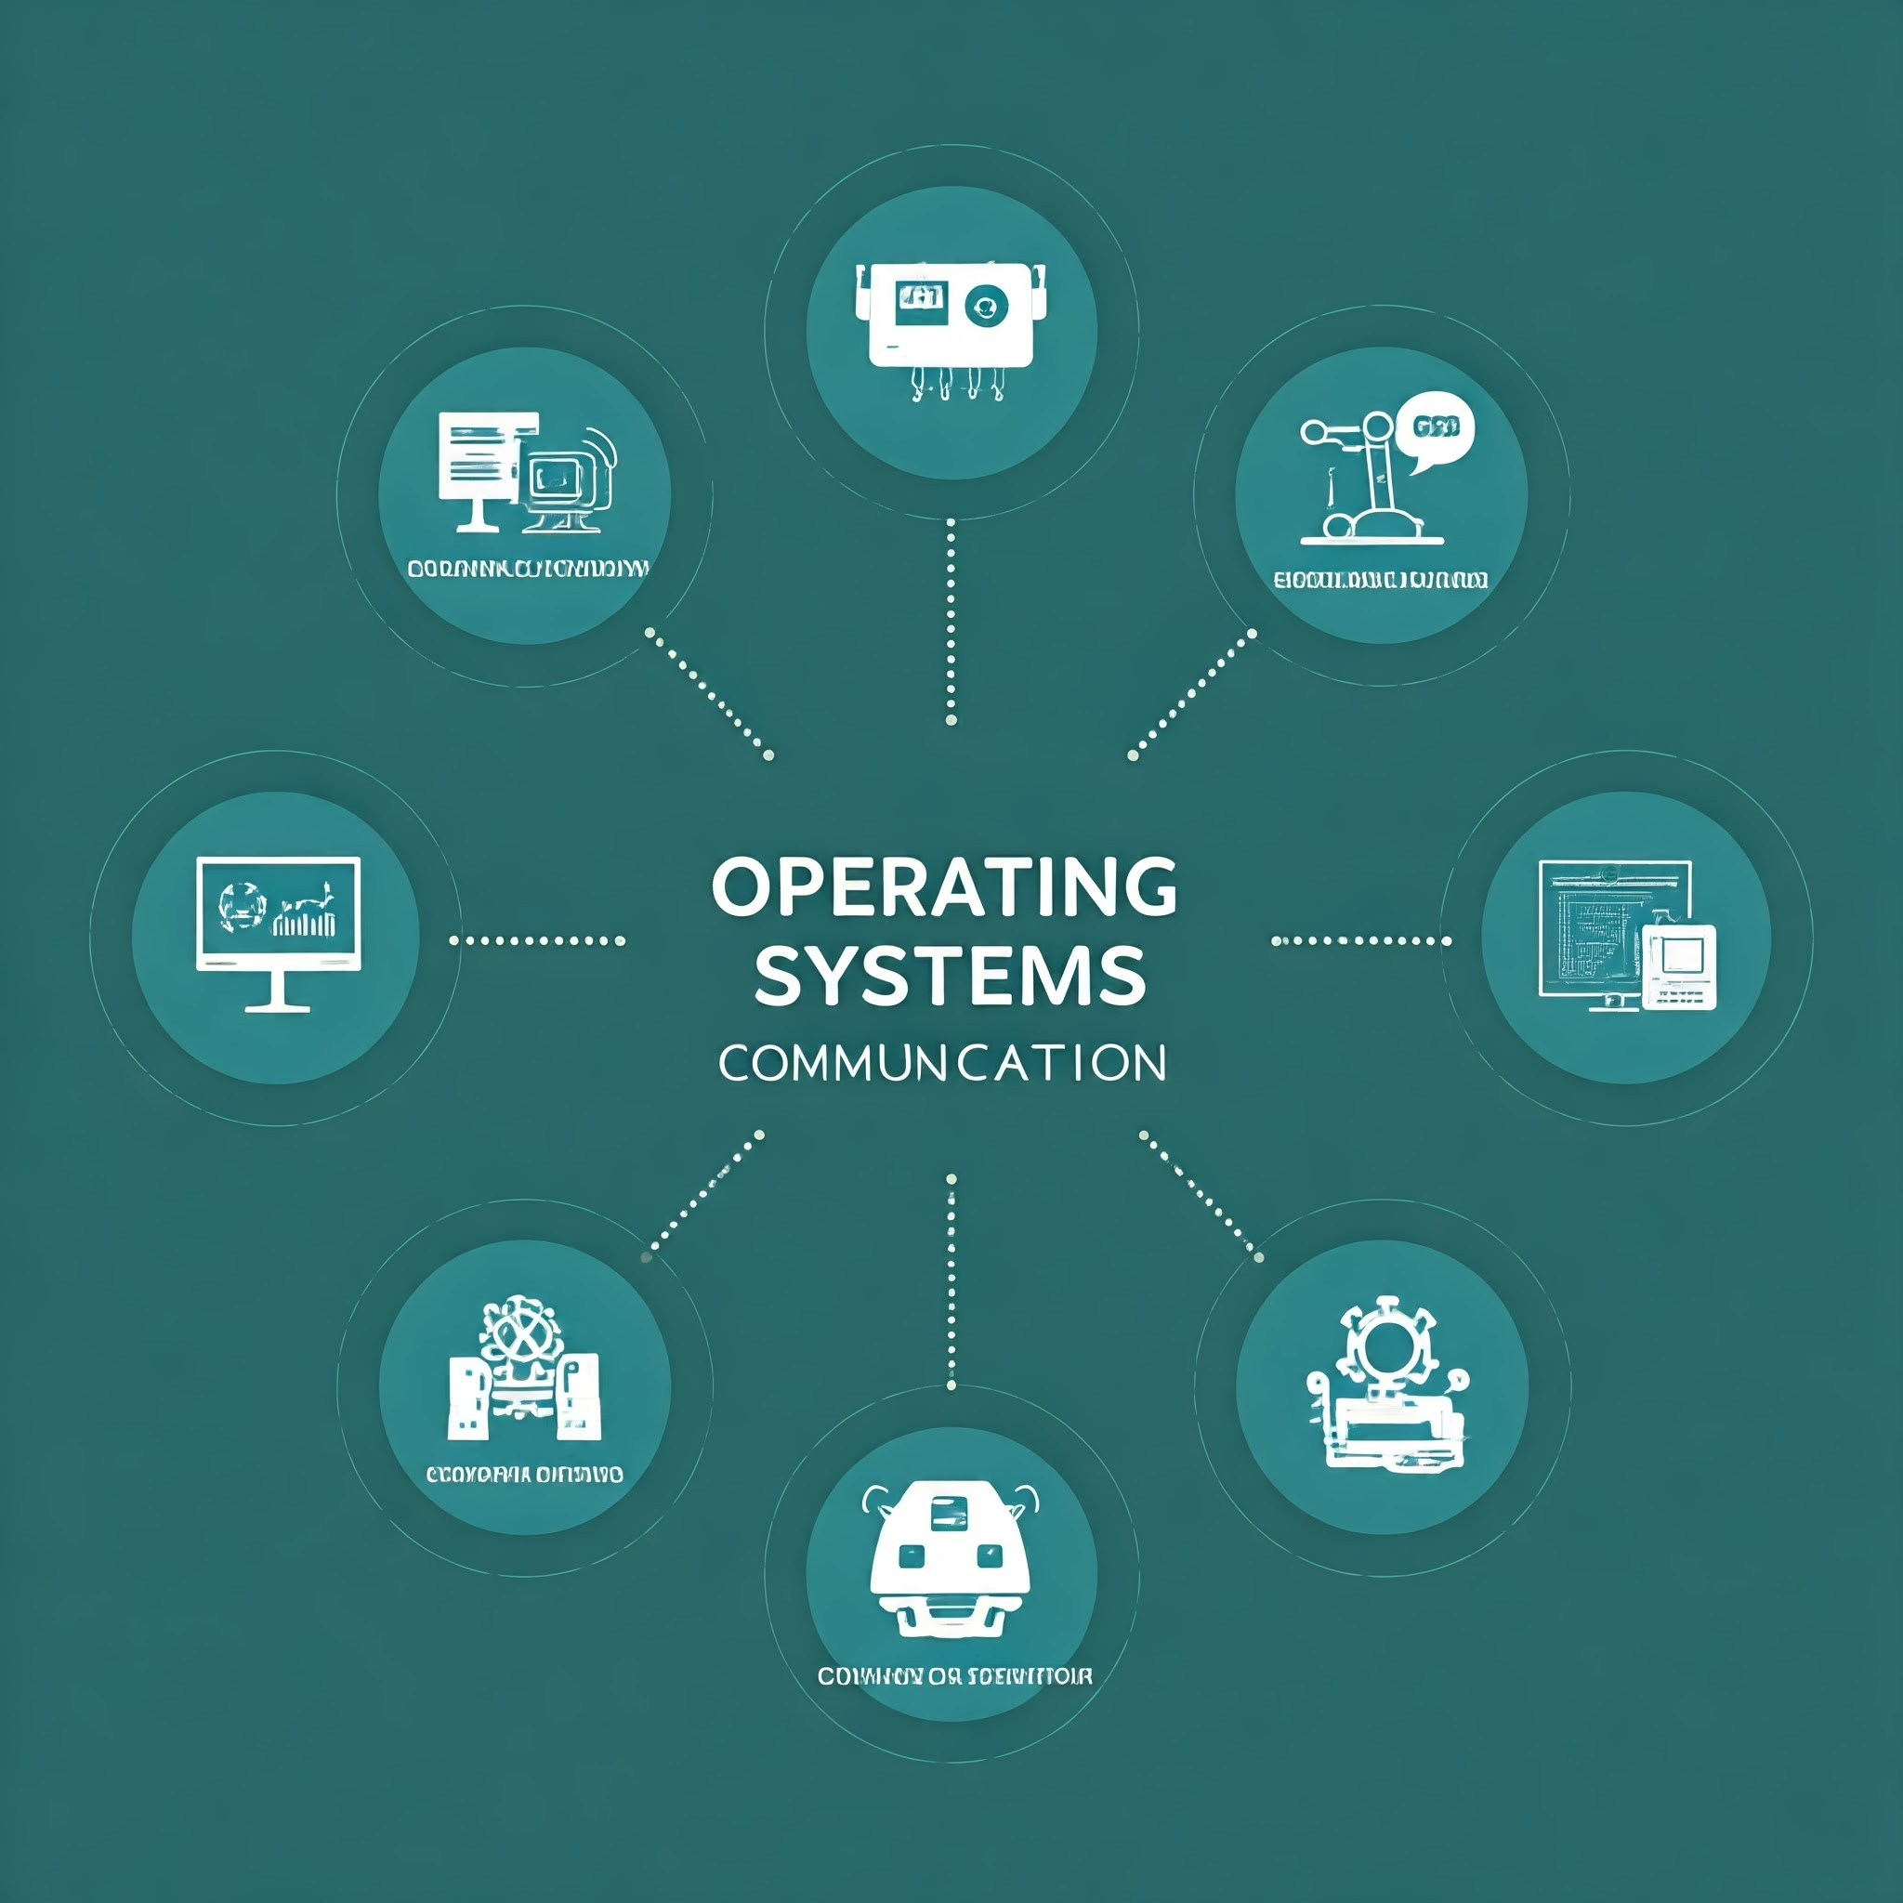
INTRODUCTION
What will this case study explore?
The role of OS in ensuring real-time data processing and task management in robotics.’
Exploration of Robotics Operating Systems (ROS) and their specialization for robotic applications

Slide 5

PROBLEM STATEMENT
Problem Description:
Robotics systems require real-time data processing, which General-Purpose Operating Systems [GPOS] may not handle effectively.
The challenge is ensuring that the OS can manage multiple tasks like sensor management, data processing, and robotic control without delays

Slide 6
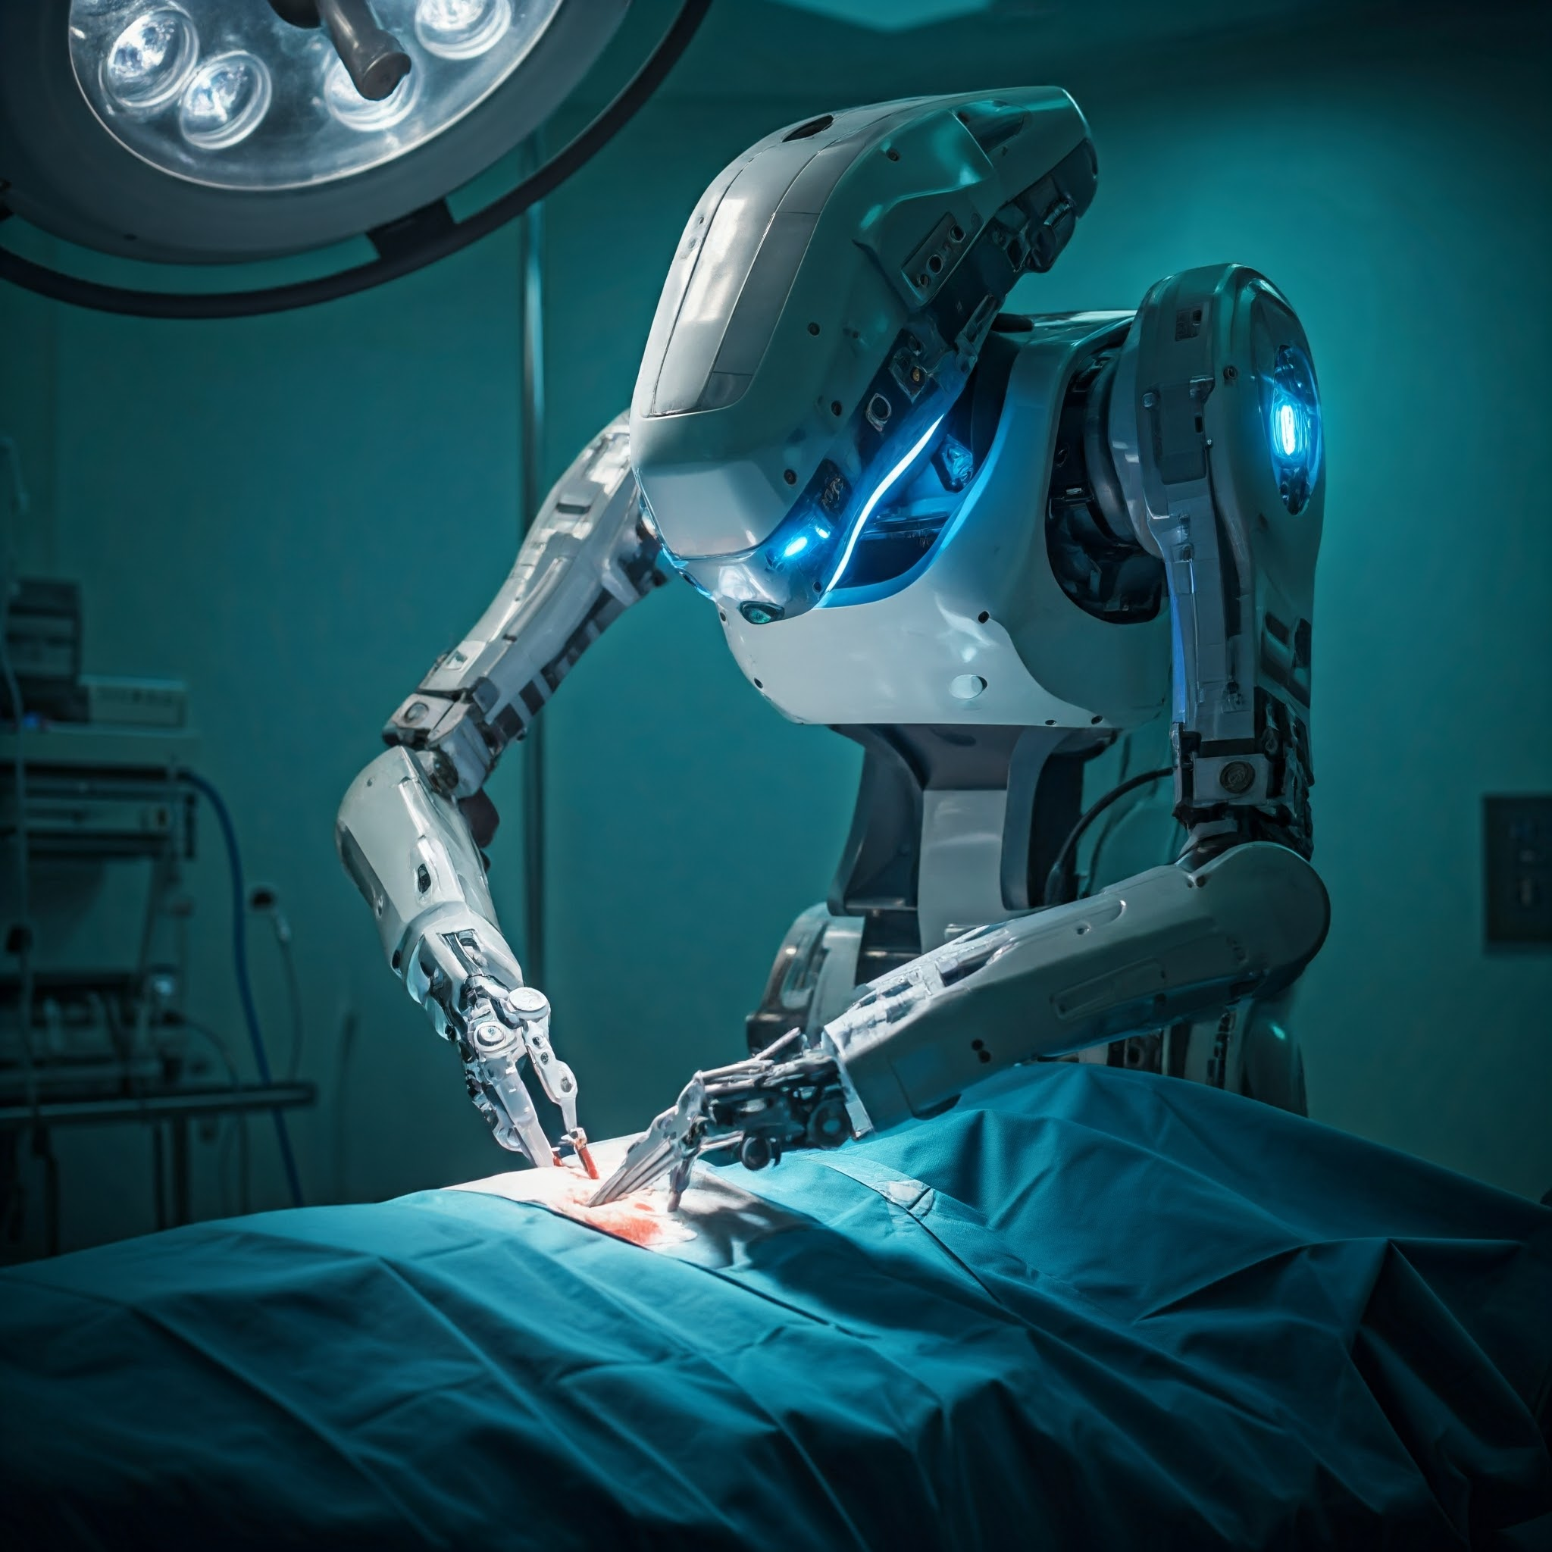
WHY IS THIS TOPIC IMPORTANT
IMPORTANCE OF THIS TOPIC:
Robotics is used in critical applications such as healthcare, manufacturing, and autonomous vehicles, when real-time decision-making is crucial for safety and efficiency.

Slide 7

METHODOLOGY
Approach Taken:
Studied and compared various Real-Time Operating Systems [RTOS] and their applications in robotics.
Examined the usage of tools like ROS [Robot Operating System], VxWorks, and QNX in real-world scenarios.

Slide 8
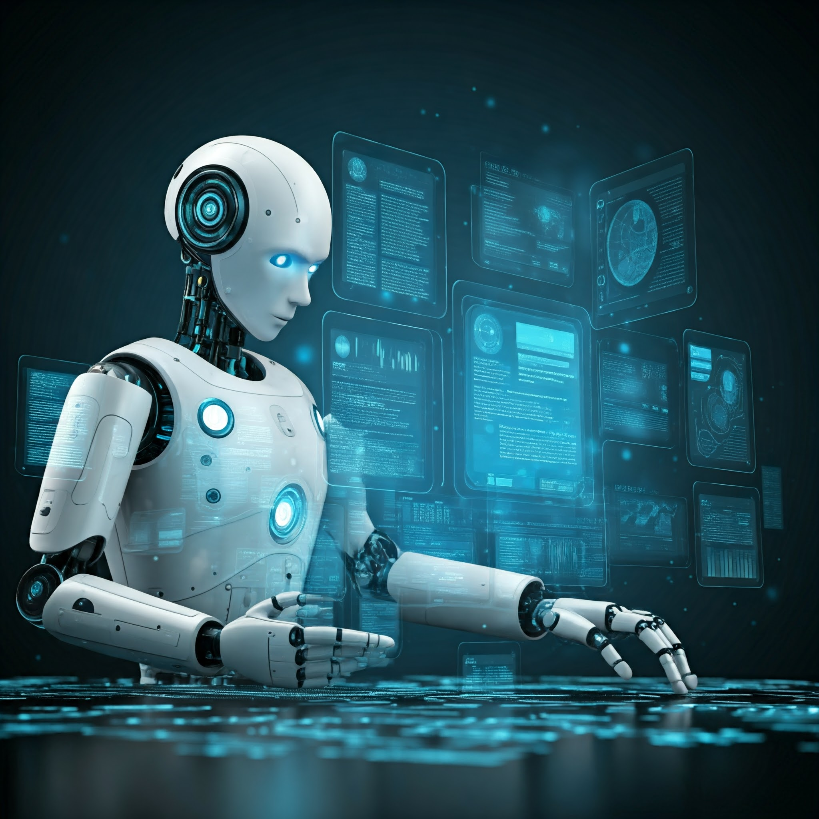
METHODOLOGY
Techniques Used:
Task scheduling algorithms and real-time data management in robotic systems.
Use of middleware like ROC for communication between software modules in robotics.

Slide 9
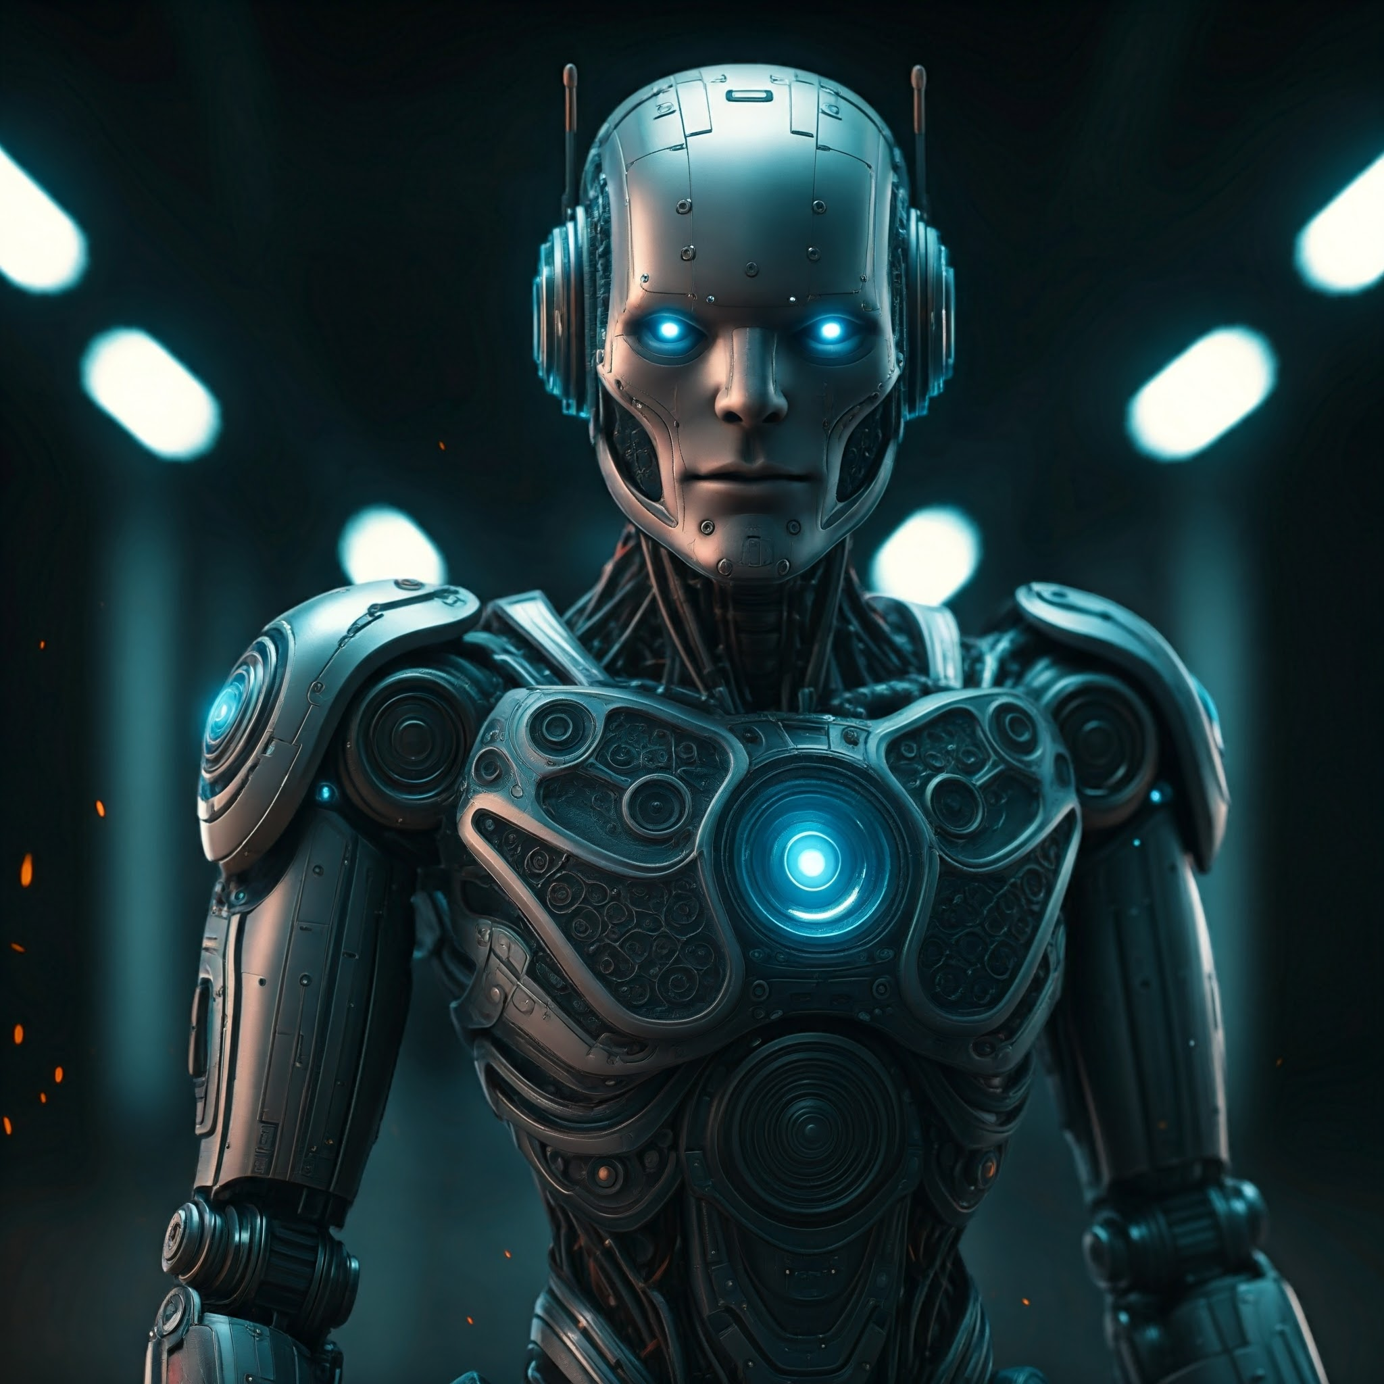
ANALYSIS
Key Findings:
Real-Time Scheduling: Ensures that tasks related to sensors and actuators are executed promptly.
Resource Allocation: OS dynamically allocates resources to maintain optimal performance.
Scalability: Modern OS, especially ROS [Robotic Operating Systems], is scalable to handle multi-robot systems.

Slide 10
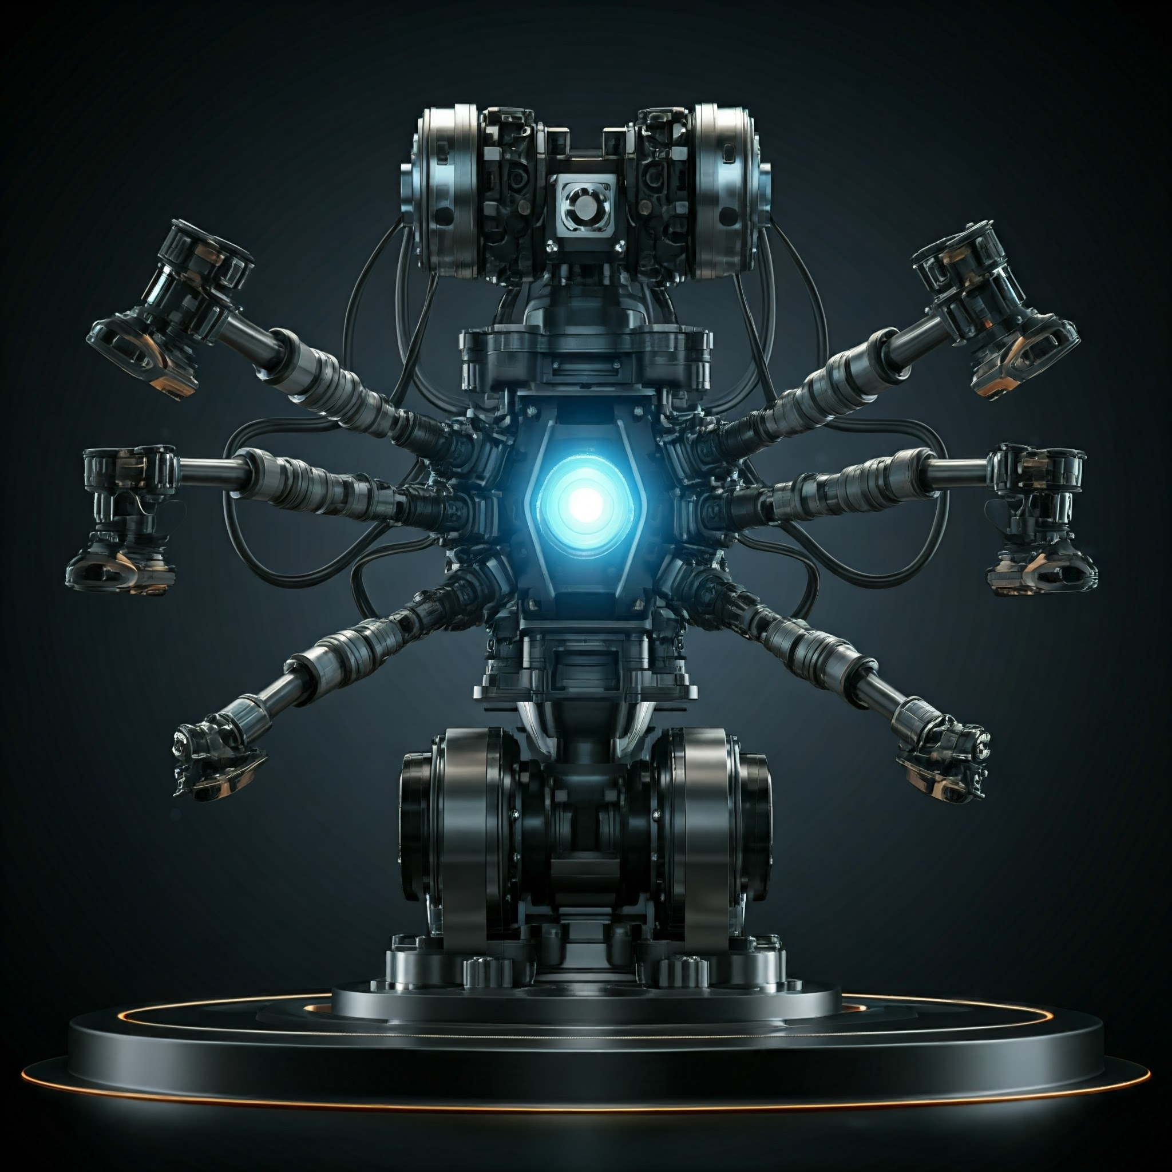
ANALYSIS
Challenges Addressed:
Managing multiple simultaneous tasks.
Ensuring low-latency responses for critical operations.

Slide 11

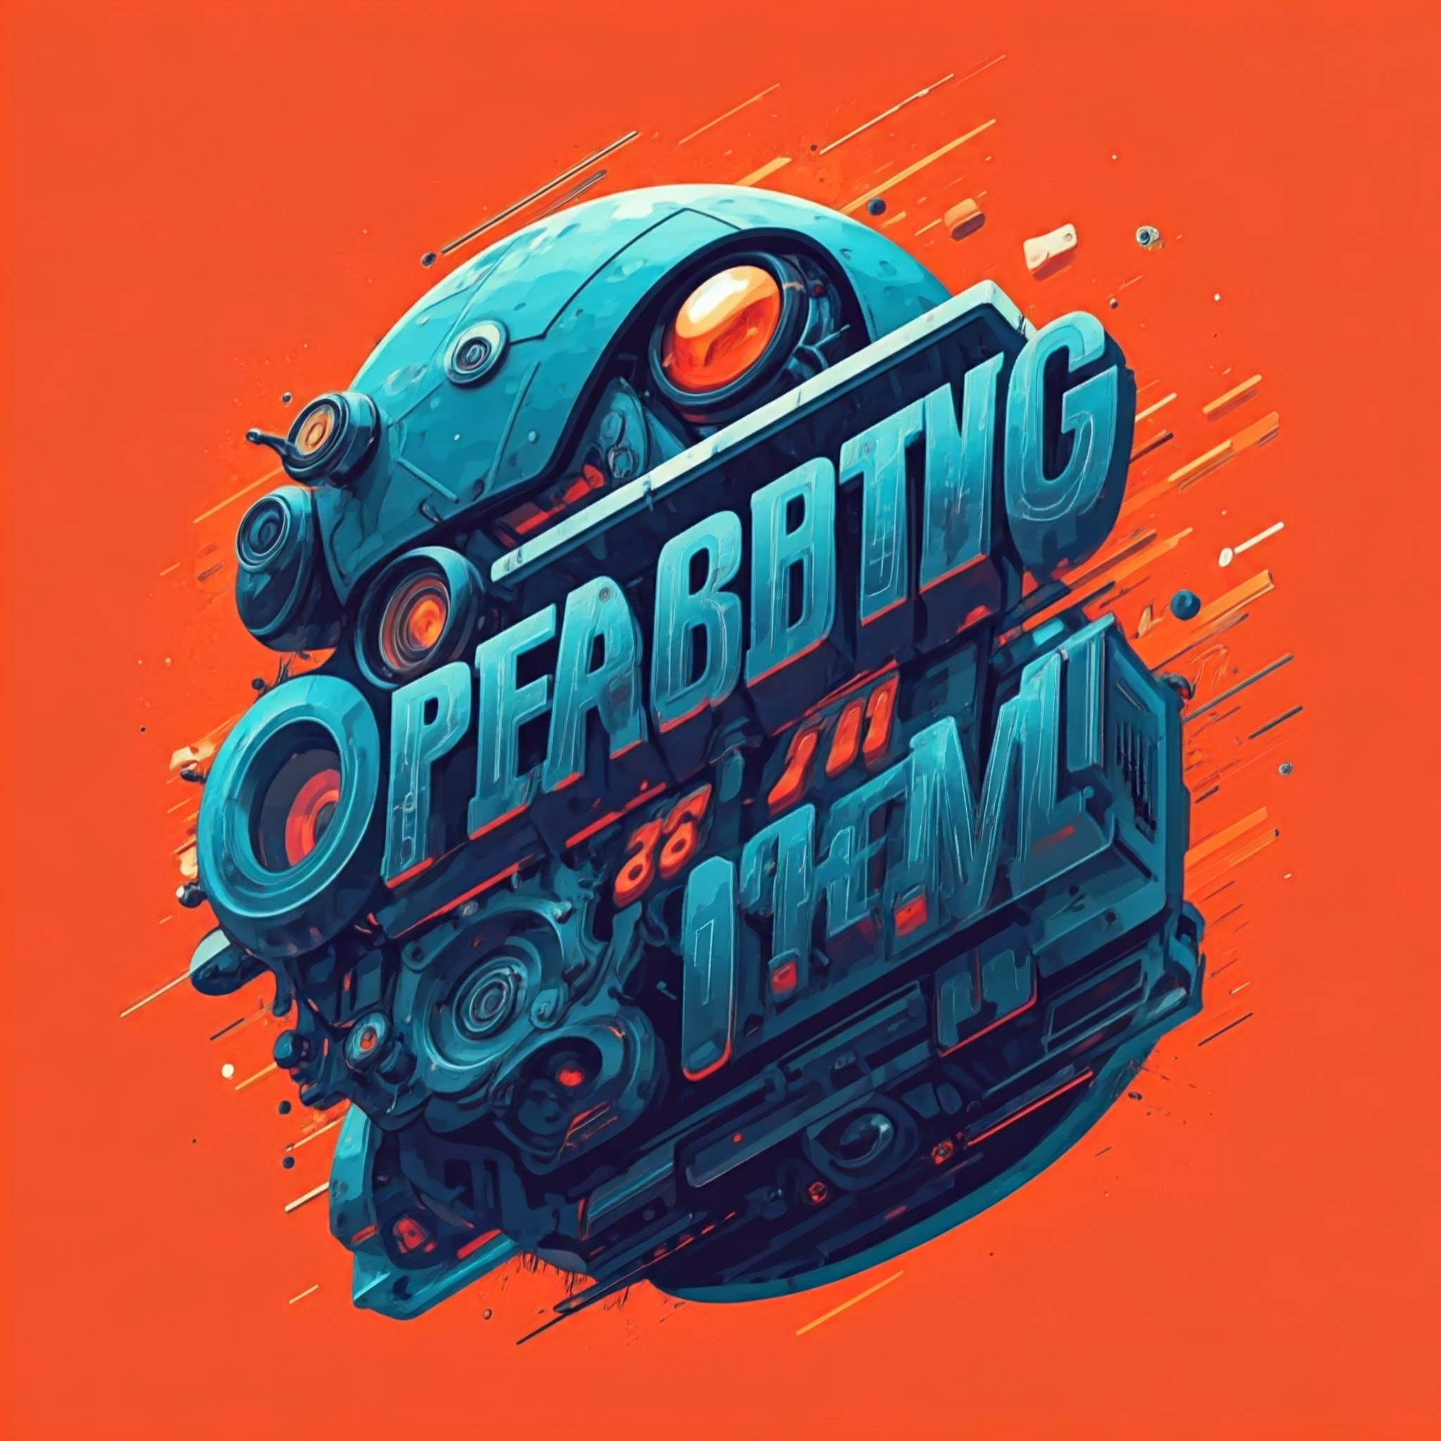
DIAGRAMs

Slide 12
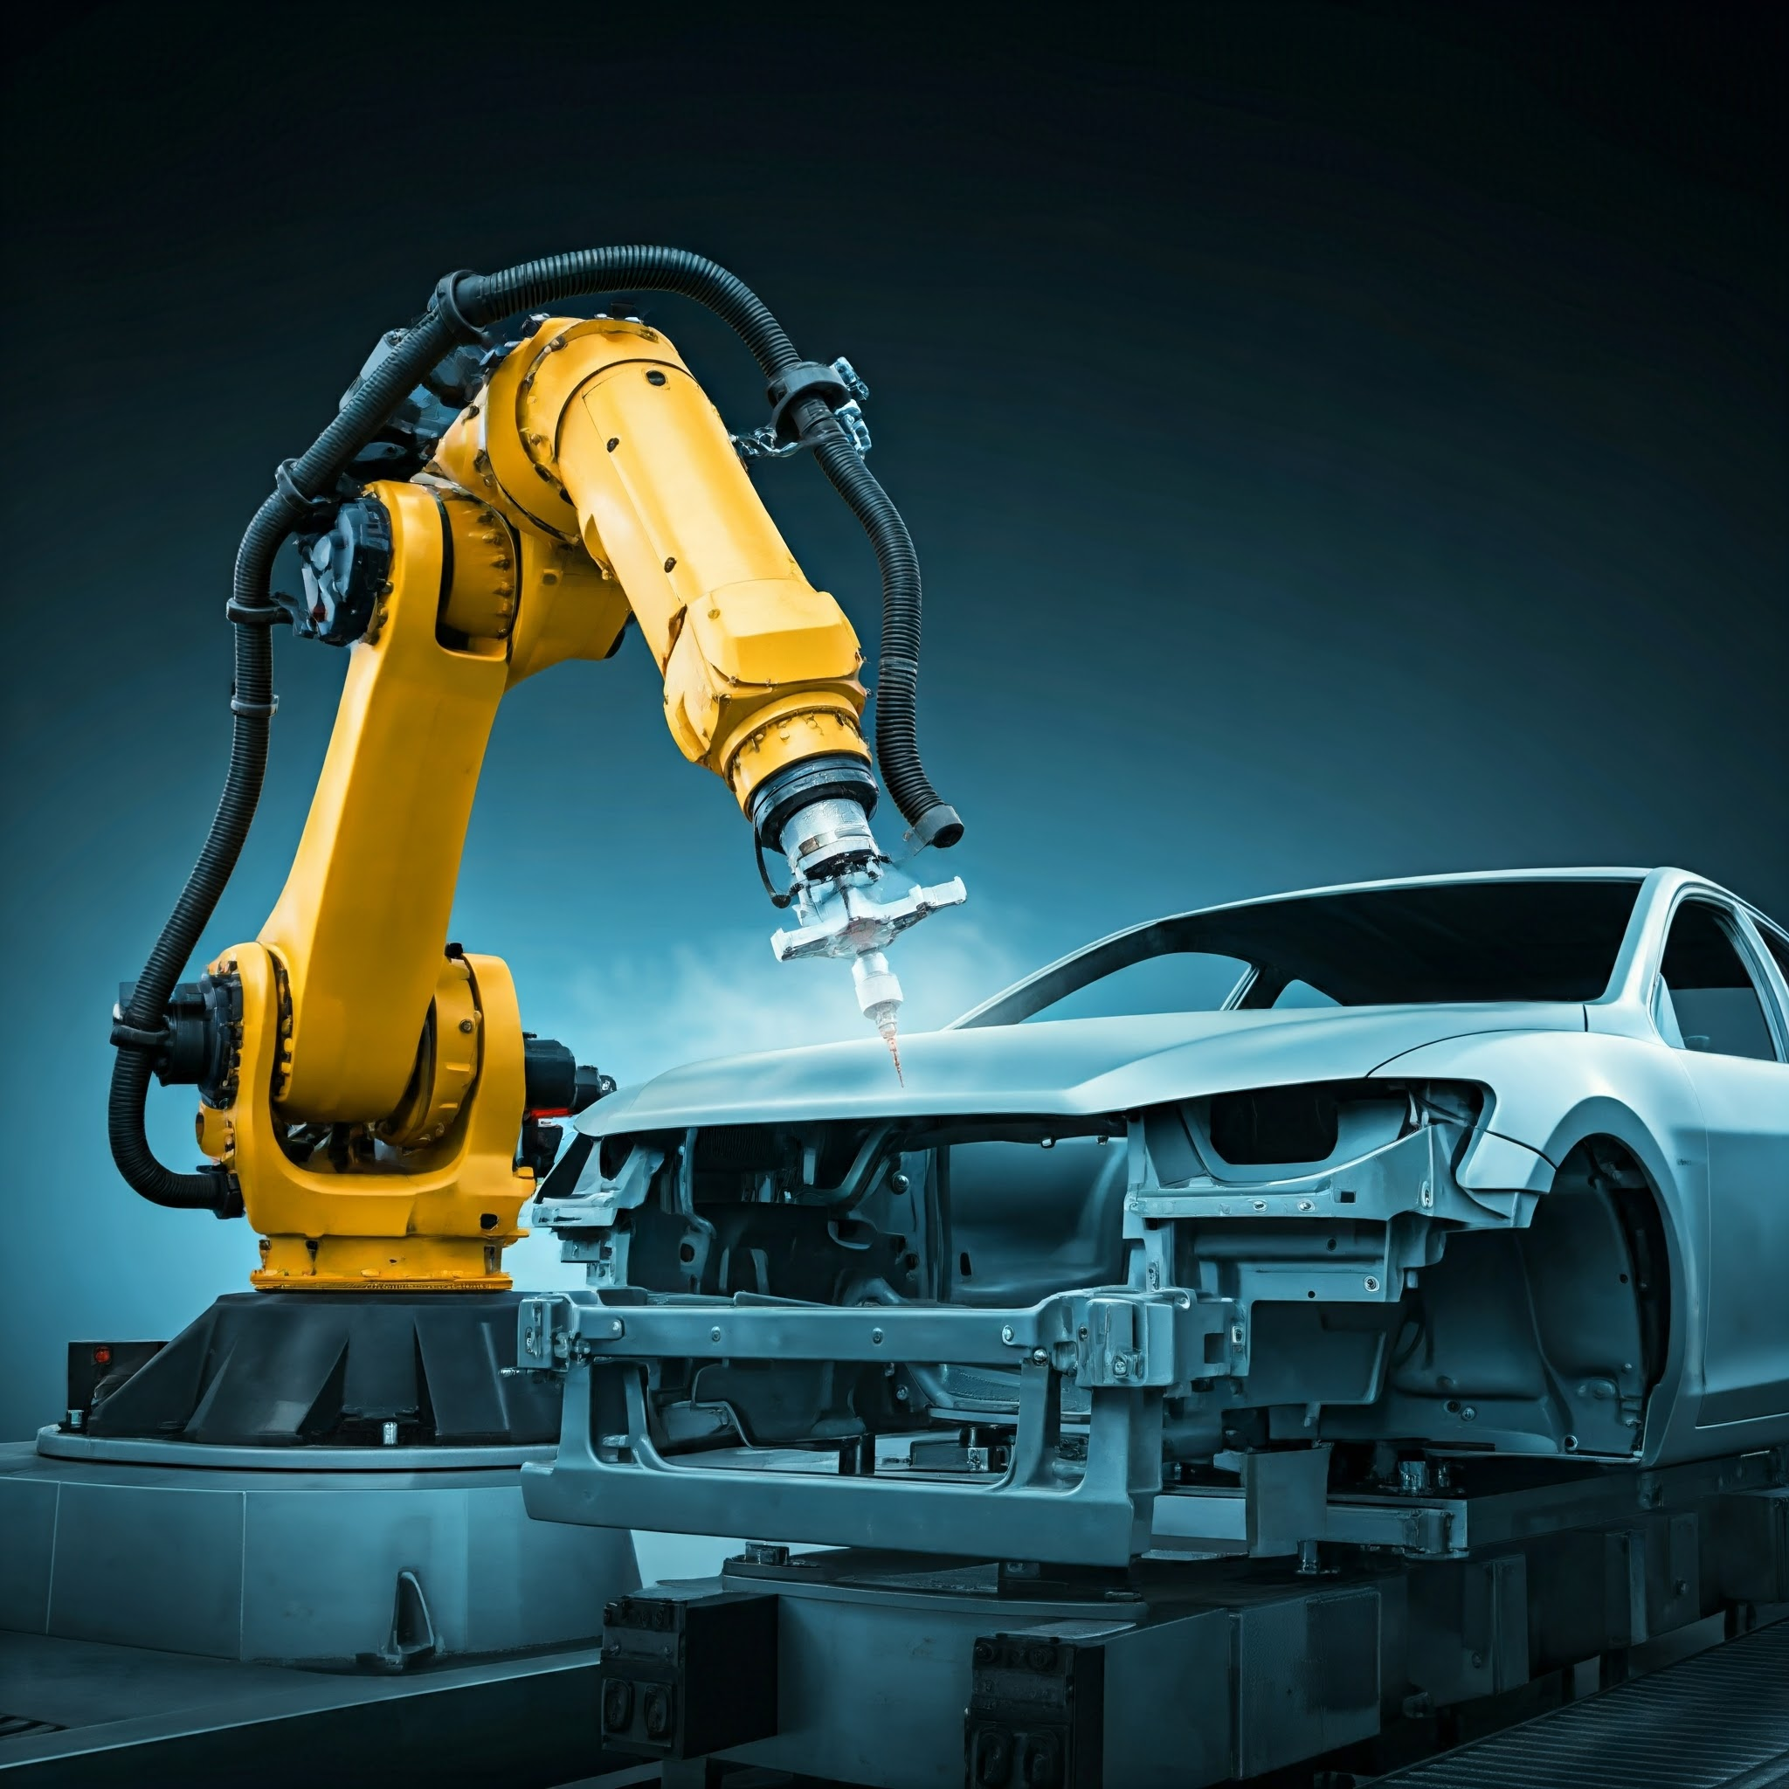
CONCLUSION
Summary:
Operating systems, particularly RTOS and ROS, are essential that robotic systems perform tasks with real-time precision.
The combination of real-time scheduling, resource management, and scalability makes OS a critical component in robotics.

Slide 13

CONCLUSION
Future Potential:
The increasing role of AI and Machine Learning is OS for robotics, enabling smarter and more adaptive systems.
Collaboration between industries: Cross-disciplinary research between CS, data science, and robotics will drive innovation

Slide 14


GRATITUDE TO MY TEACHER
Thank You for your guidance and support!
Your invaluable insights have inspired me to explore the fascinating world of Operating Systems and Robotics. Your dedication to teaching has made a lasting impact on my learning journey.
Yout encouragement means a lot!
I appreciate your patience and encouragement, which have motivated me to strive for excellence in my studies. Thank you so much teacher, for being an amazing mentor in my life.

Slide 15

GRATITUDE TO MY AUDIENCE
Your Support is Greatly Appreciated !!!
Thank you for taking the time to watch my presentation. Your interest in my work inspires me to create more informative content
Let’s Continue Learning Together !!!!
I am grateful for your engagement and feedback. Your encouragement motivates me to keep exploring new topics and sharing my knowledge with all of you!.
If you have different points of view or suggestions for improvements, please feel free to share them. I encourage you to comment on anything you wish! Your insights are invaluable as I strive to make my content even better.

Slide 16
